Slide 1
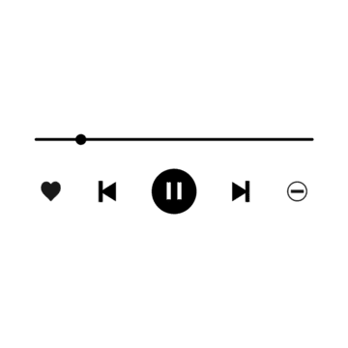

ONLINE MISIC PLAYER WITH JAVA
PRESENTED BY :
Rahul kumar
Shivam singh
Kaif Ansari
Rishi Maddheshiya

Slide 2

INTRODUCTION TO MUSIC PLAYER
In this presentation, we will explore Java as a powerful tool for crafting an online music player. We will delve into the creative process, the essential components, and how to bring your musical ideas to life through coding.
An online music player is a software application that allows users to stream and play music over the internet. In Java, you can create a basic version of an online music player that can play local audio files, while more advanced versions would involve handling online streams

Slide 3
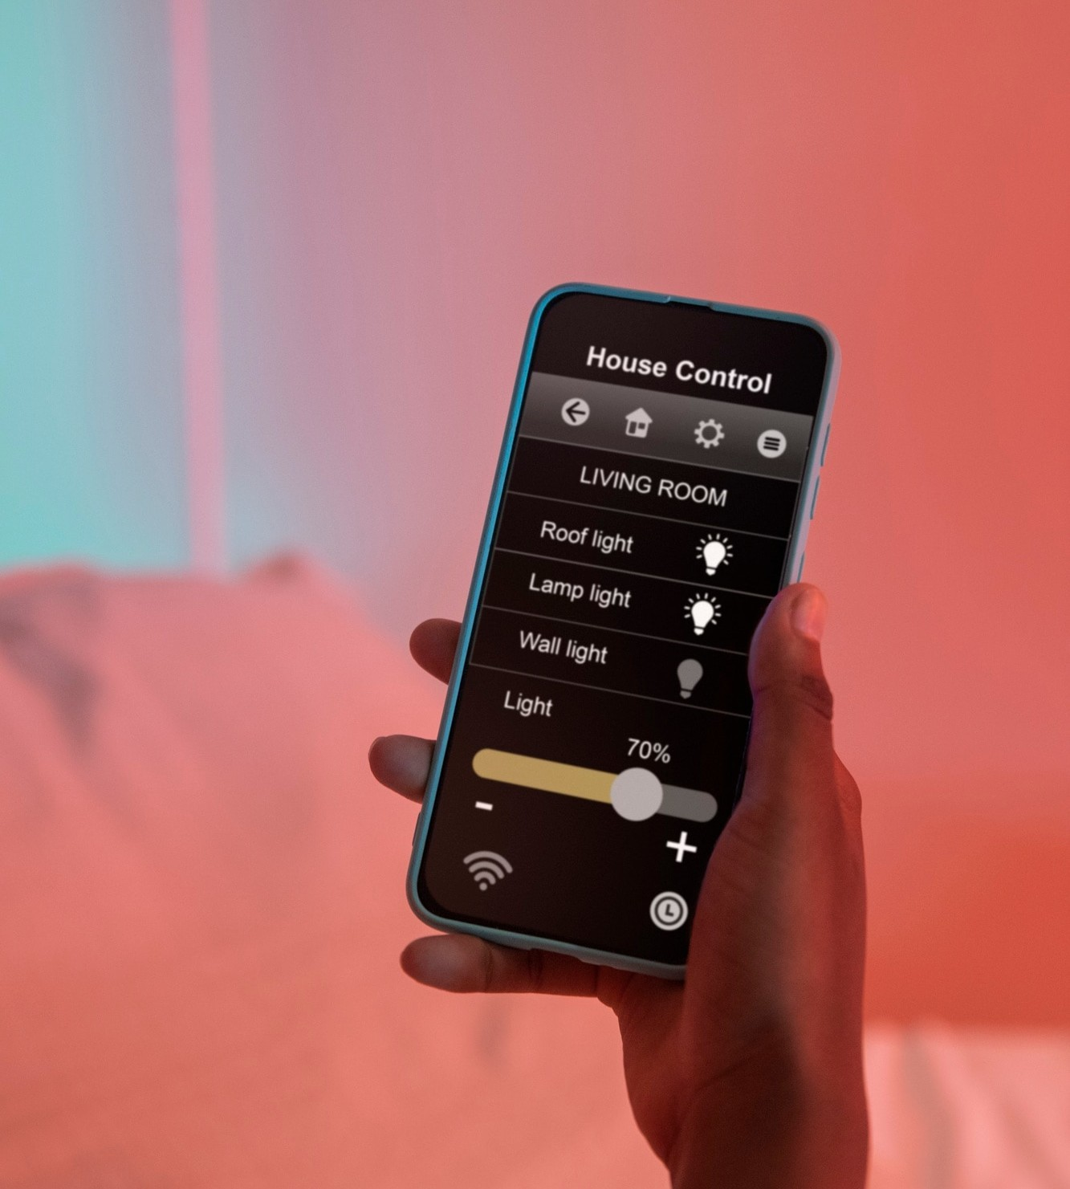
Core Components
Graphical User Interface (GUI): The interface through which the user interacts with the music player, usually consisting of buttons like Play, Pause, Stop, etc.
Audio Processing: Java libraries like JavaZoom’s or javax.sound.sampled are used to play audio files.
Event Handling: You need to manage user interactions with the music player, like clicking the Play button.

Slide 4

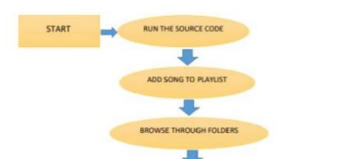
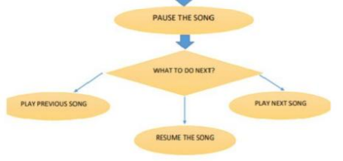
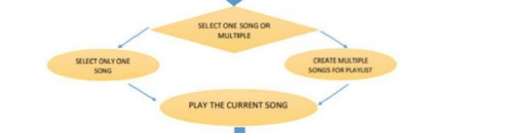
Flowchart

Slide 5
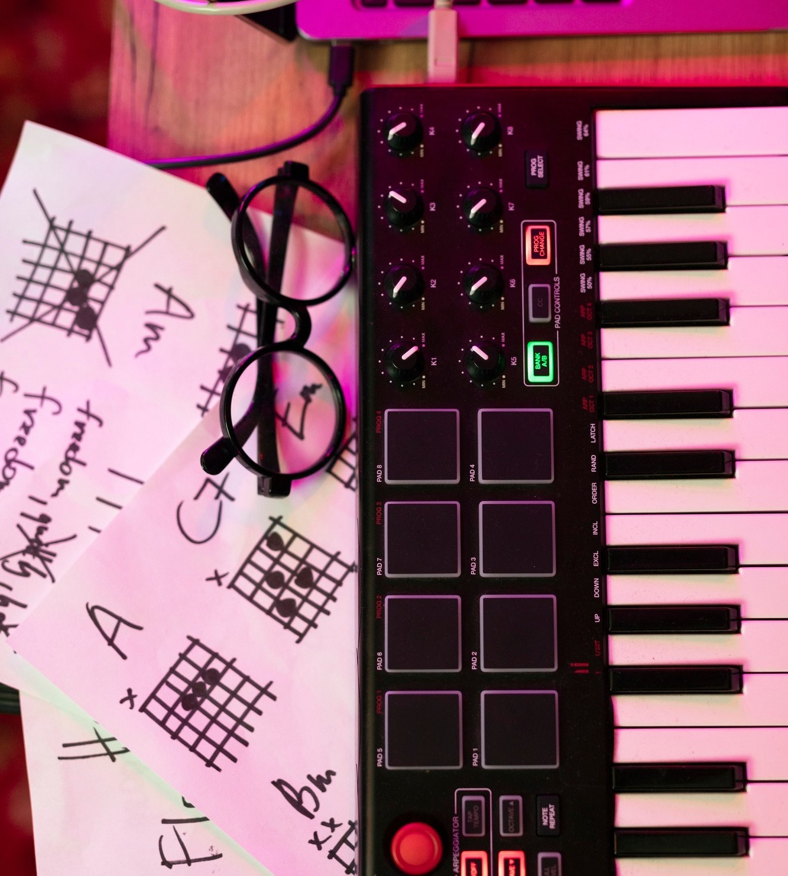
Utilizing Java libraries such as JavaFX and JLayer, we can implement features like play, pause, and skip. The coding process allows for customization and creativity, enabling developers to create a unique experience that resonates with users. Testing and iteration are key!

Slide 6
CONCLUSION & NEXT STEPS
In this introduction to building an online music player with Java, you've learned how to set up a basic framework for a music player application. Using Java's built-in javax.sound.sampled package, we've demonstrated how to play .wav audio files, while also exploring the possibility of using the JLayer library for playing MP3 files. Additionally, we've created a simple graphical user interface (GUI) using Swing, which allows users to interact with the player by clicking Play and Stop buttons.
Add More File Format Support:
Integrate MP3 or even online audio streaming capabilities by extending the functionality with libraries like JLayer or Apache Commons Audio.
Add Pause/Resume Functionality:
Implement buttons that allow you to pause and resume audio, so the user has more control over playback.
Implement Volume Control:
Add volume control sliders to allow users to adjust the sound output.
Create a Playlist Feature:
Enable the user to load multiple songs and create playlists. You could implement next/previous buttons to switch between tracks.

Slide 7


Thanks!

